Slide 1
Engaging Modern L e arner s For Life

Slide 2
Message 101
Learn about the platform and what you can do!
Notes:
Webinar Resources: https://support.signalvine.com/hc/en-us/articles/23861101443341-Message-101-Training-Webinar
---

Slide 3
Agenda
What is Message
Maintenance
Messaging 101
Program Management
Resources
Q&A
Close

Slide 4
What is Message?

Slide 5
Message 101

Slide 6
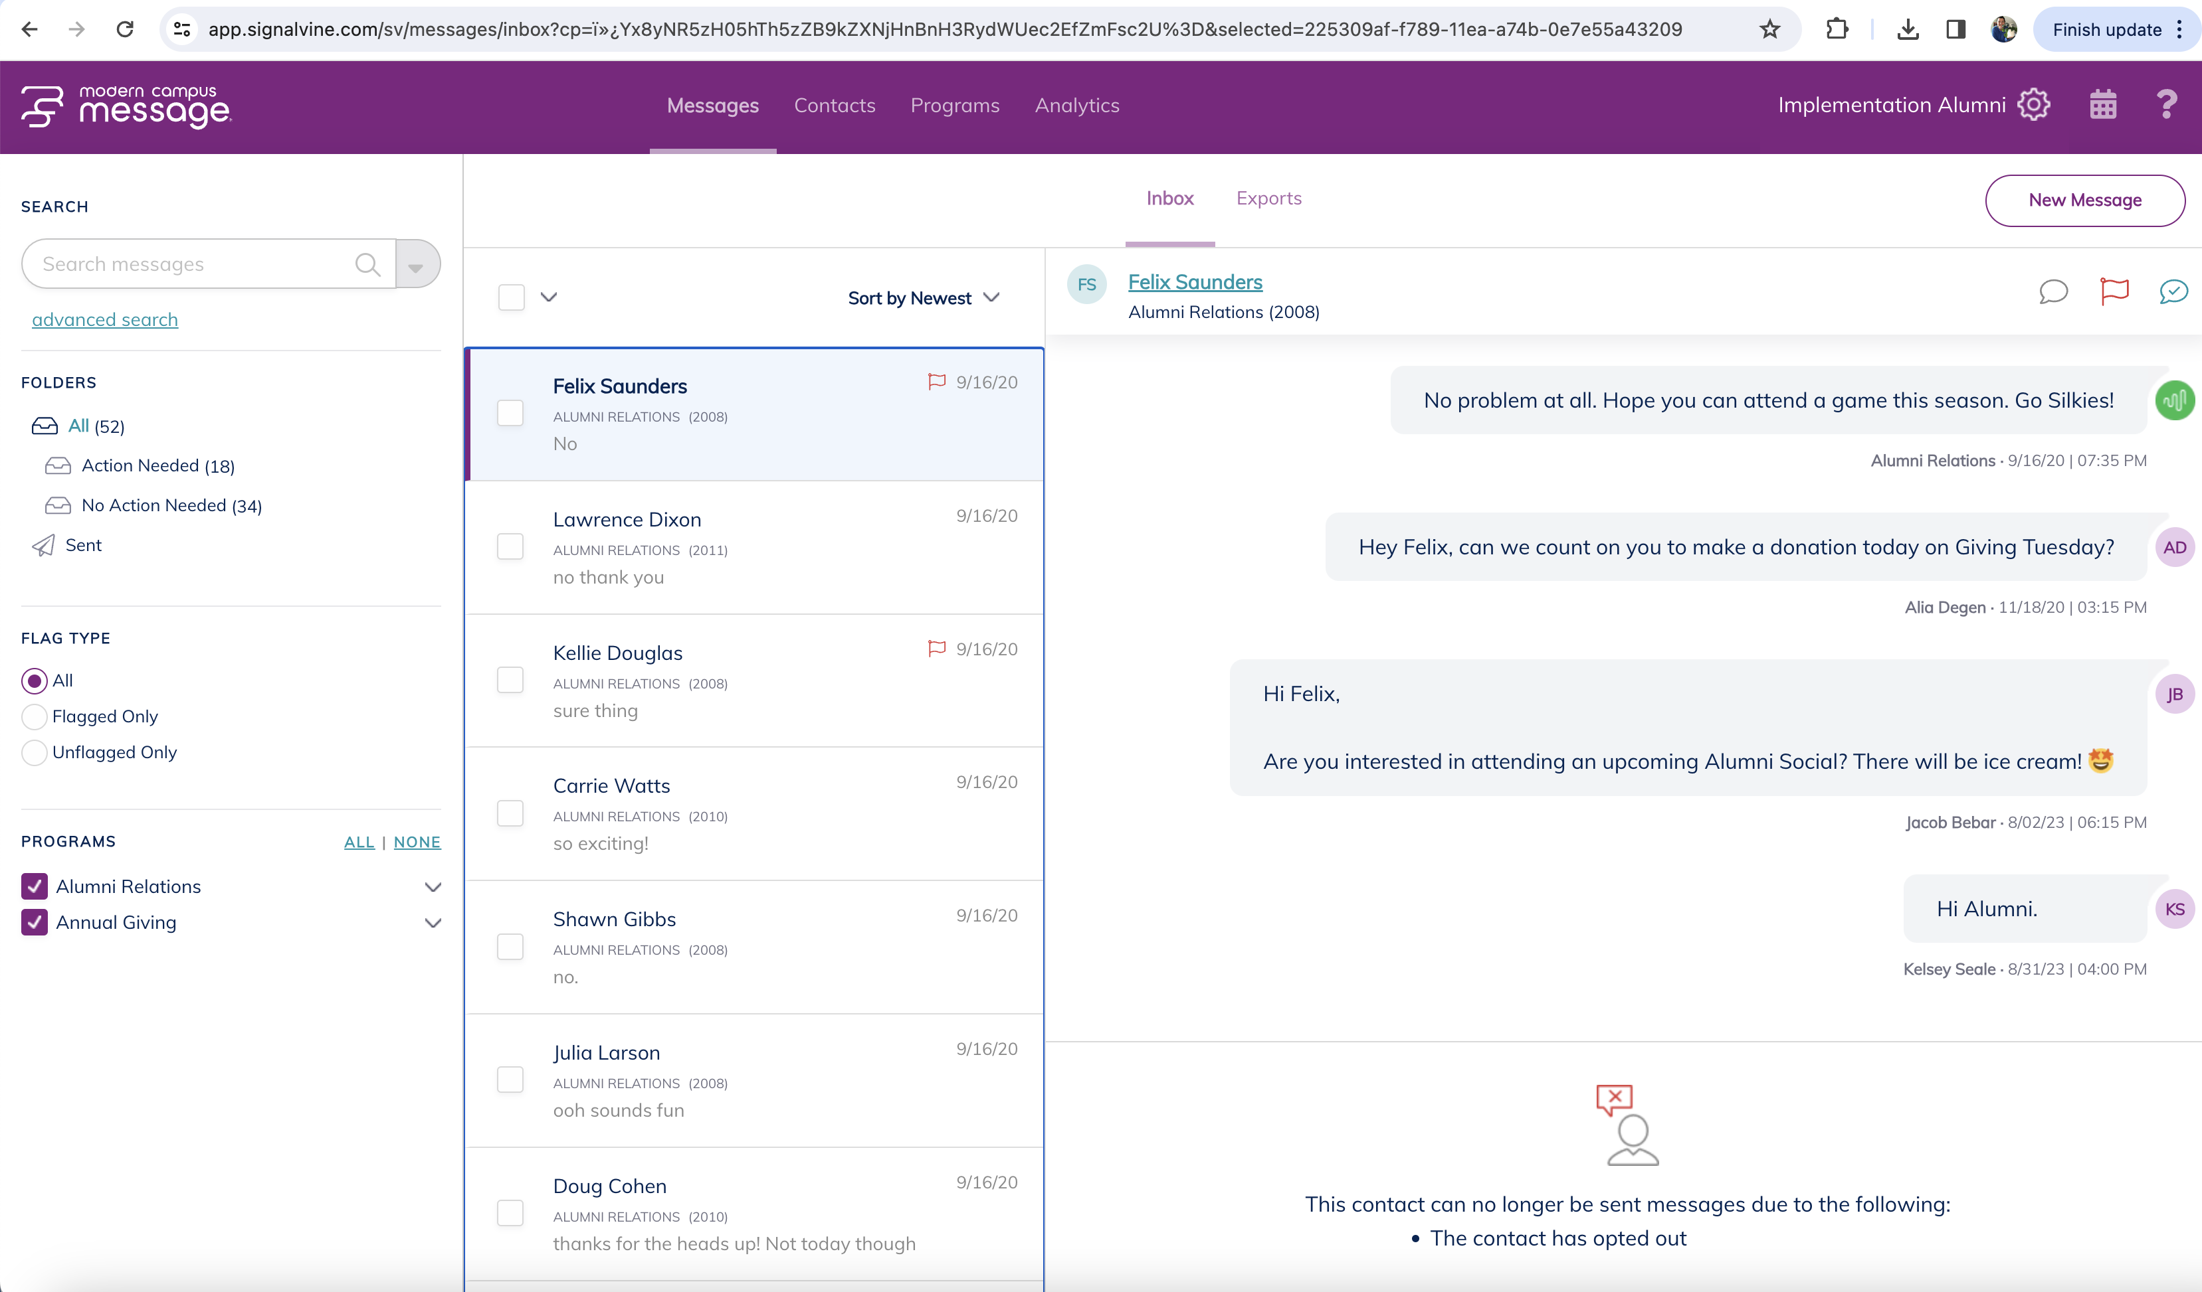
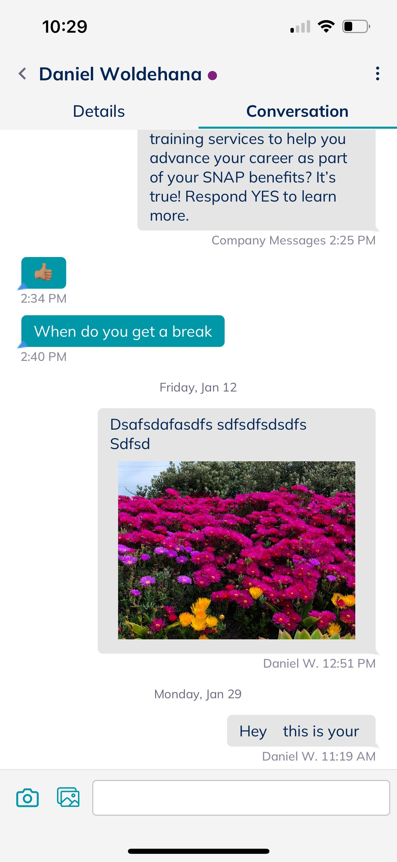
Mobile App
Search “Modern Campus Message”
Web App

Slide 7
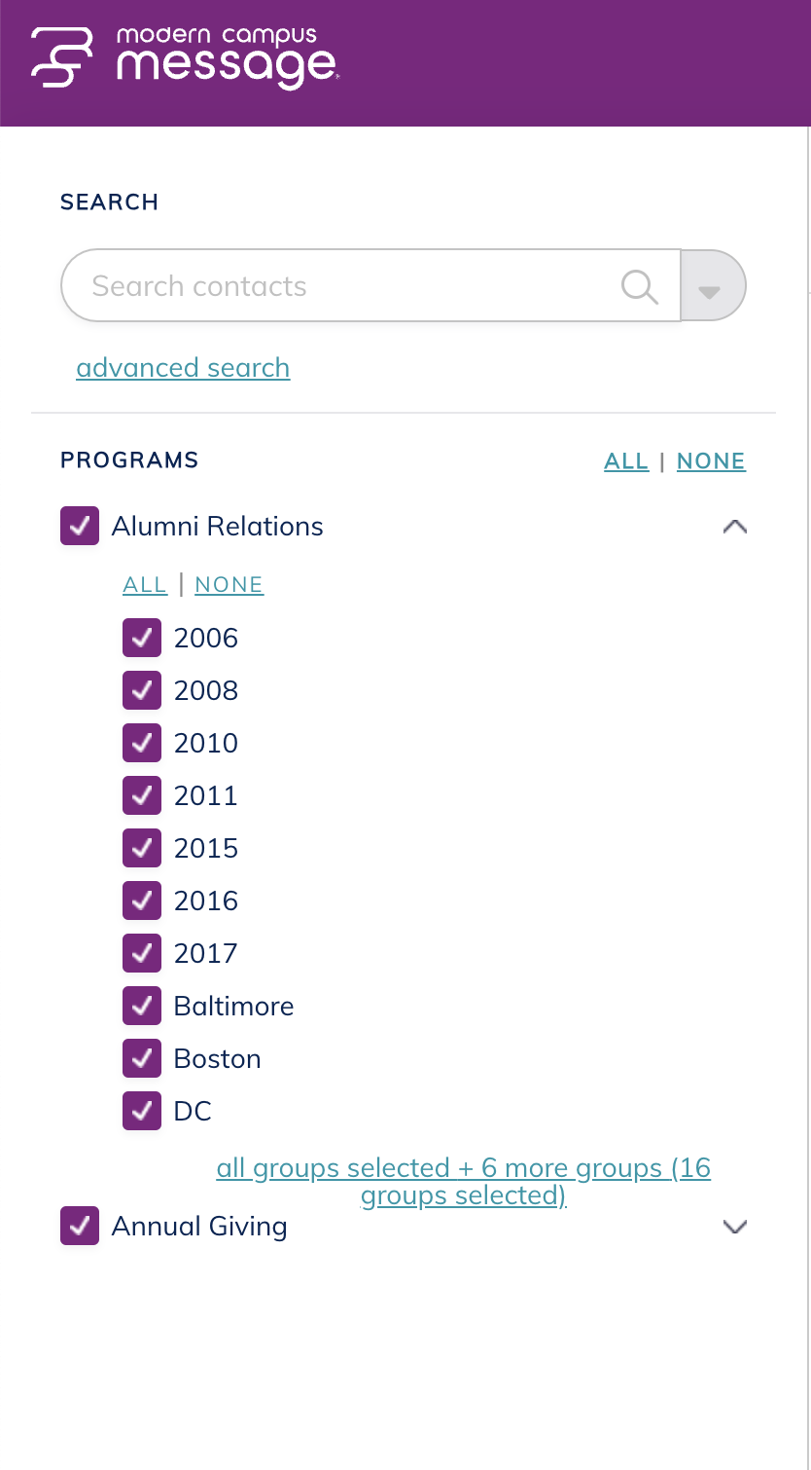
Your Role in Message
Account Admin
All student access
Invite users
Update settings
Import data
Program Admin
All assigned program access
Invite users to their program
Update settings of their program
Import data to their program
Counselor
Access to the students on their caseload

Slide 8
Message Maintenance

Slide 9
app.signalvine.com
Bookmark the url!
Notes:
app.signalvine.com

Slide 10
Message Inbox

Slide 11
Inbox Folders
All
Action Needed
No Action Needed
Sent

Slide 12
Action Needed vs. No Action Needed
Focus on Action Needed
Messages that (might) require your attention
Be proactive with your inbox management!

Slide 13
Message Actions / Organization

Slide 14
Contacts Tab
Notes:
Webinar Resources: https://support.signalvine.com/hc/en-us/articles/23861101443341-Message-101-Training-Webinar

Slide 15
Poll #2
What is your user role?
What type of messages do you typically send?

Slide 16
Texting 101

Slide 17
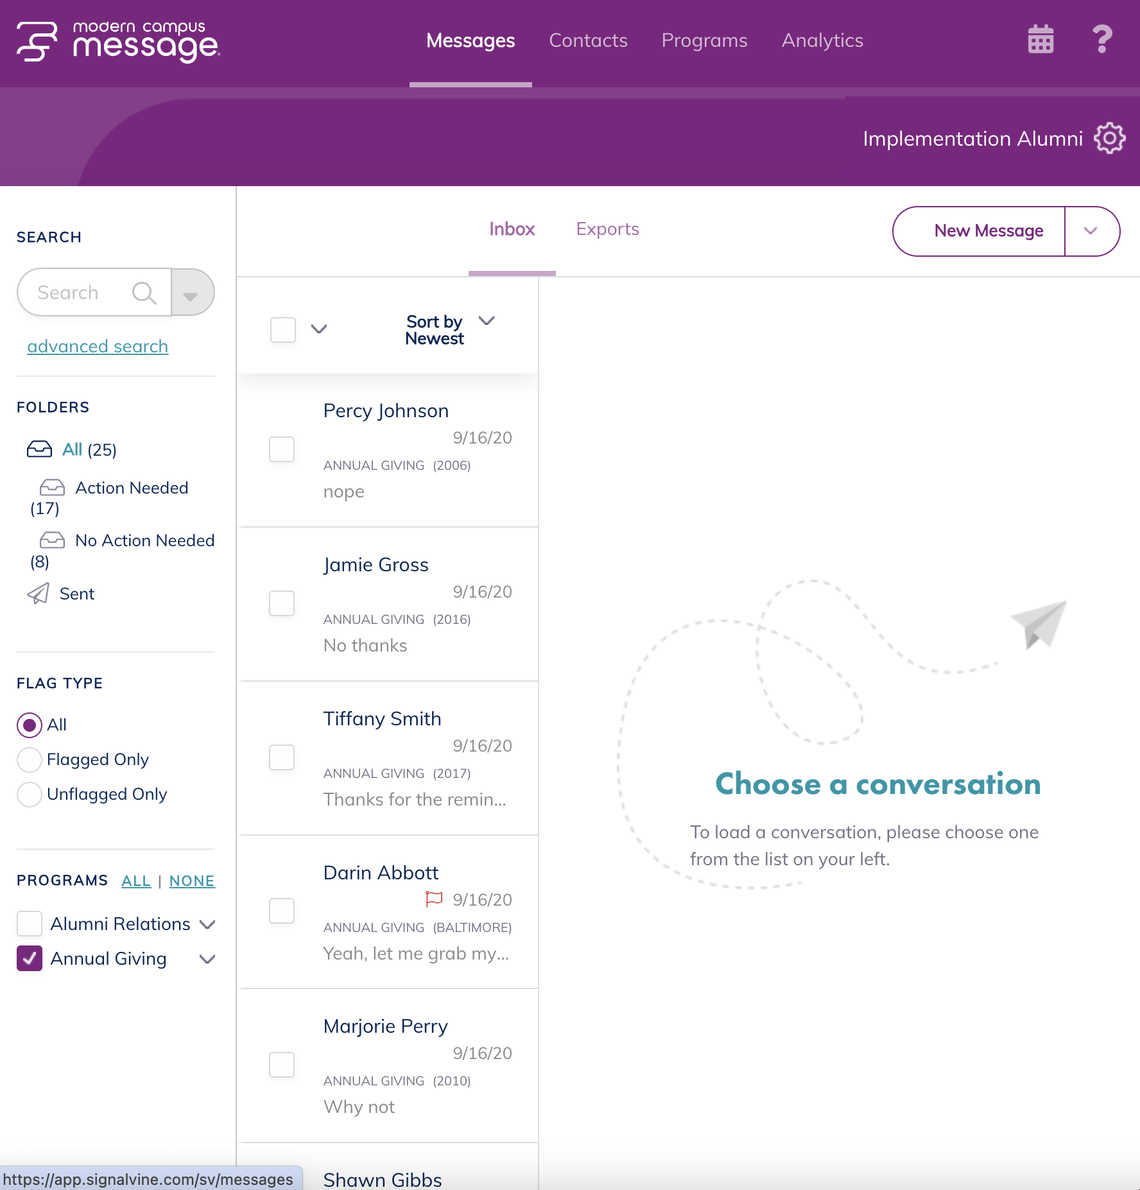
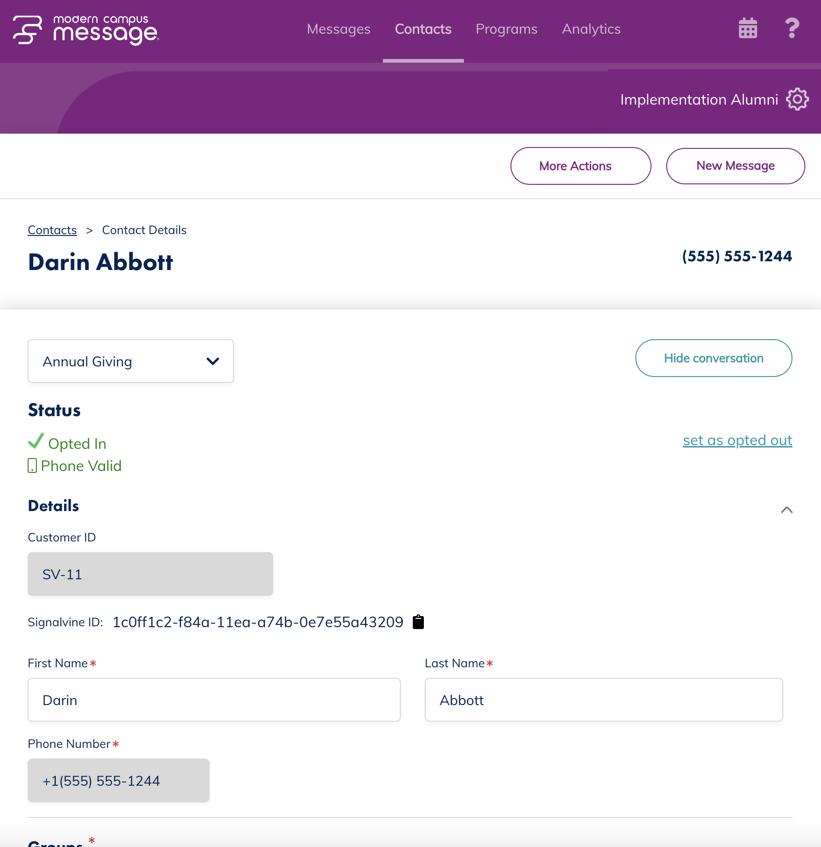
Start Your Message

Slide 18
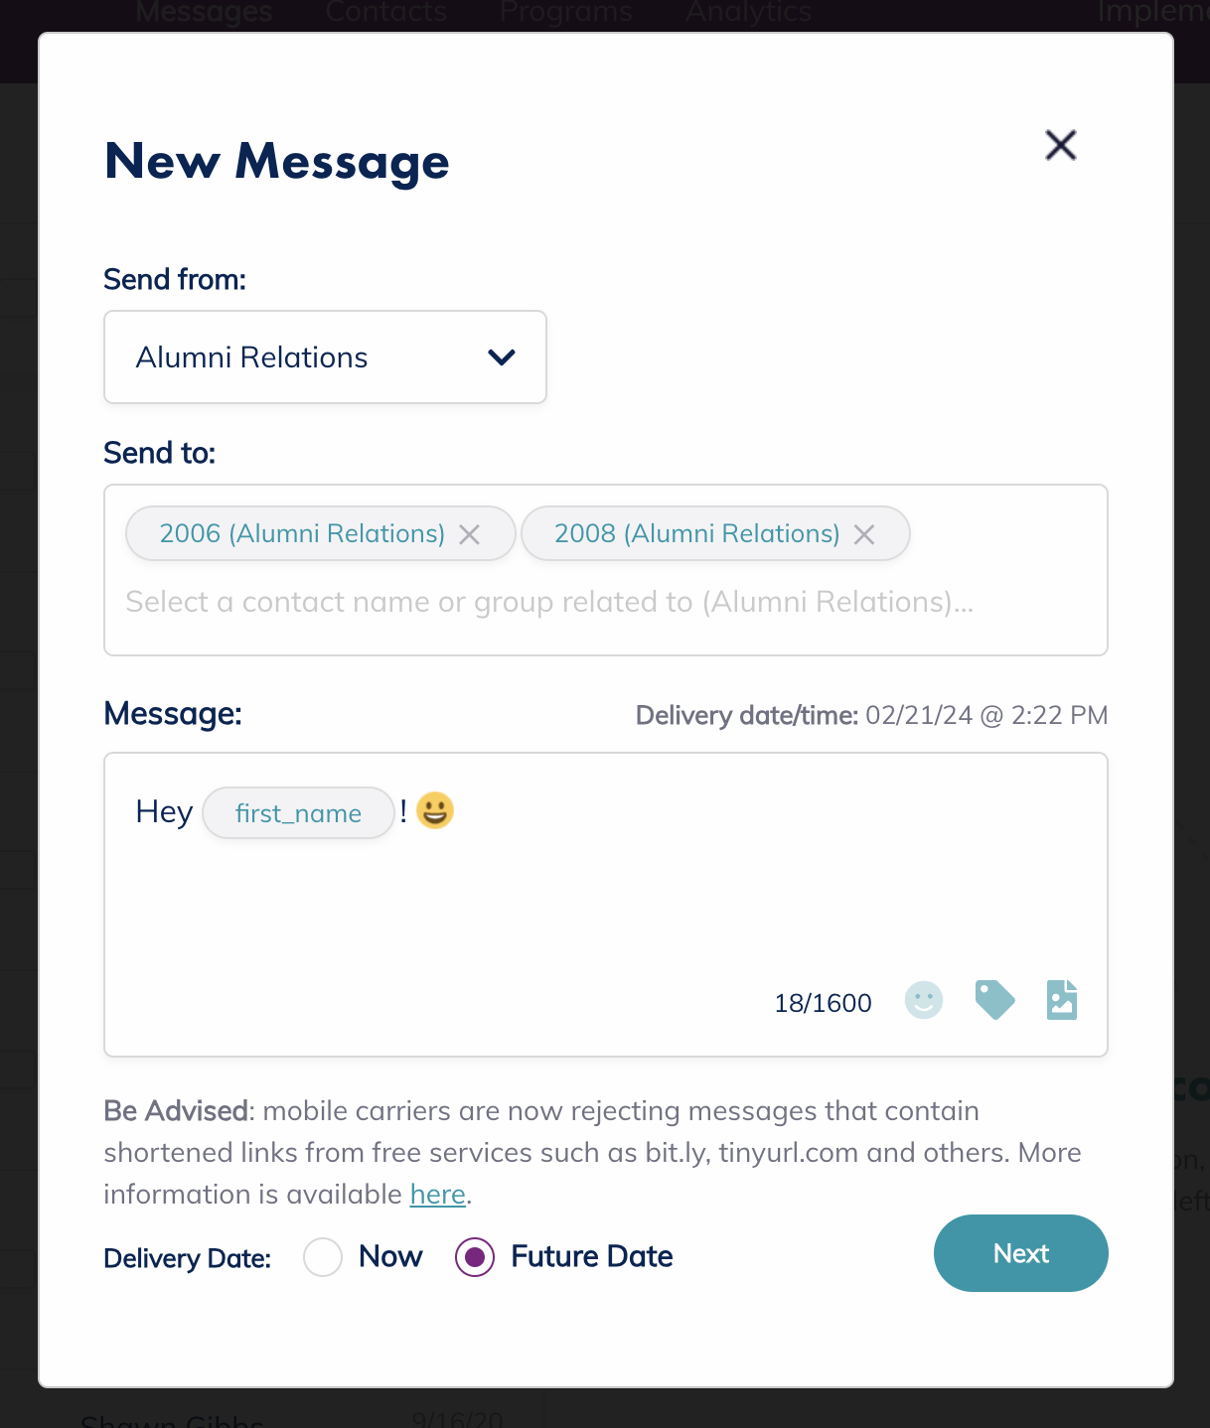
One to One Messaging
Hit “New Message”
Specify program and contacts
Personalize Message
Send now or schedule for the future

Slide 19
Bulk Messaging
Sending texts to more than one contact
Advanced Search
Copy and Paste
Program Messages

Slide 20
Advanced Search
Narrow down contacts
Use niche criteria

Slide 21
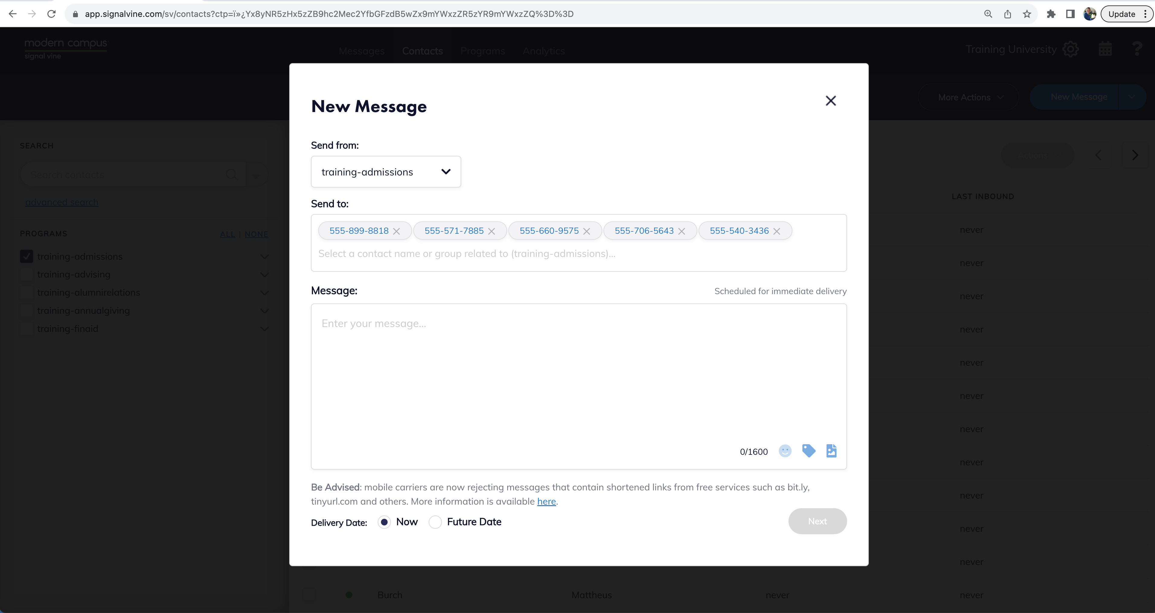
Copy and Paste a List
You already have a list of phone numbers or IDs
You want to send a one-time message
You don’t need to save any response data

Slide 22
Comma Separated List

Slide 25
Copy and Paste!

Slide 26
Bulk Messages Do Not…
Change data
Save data
Make new groups in Message

Slide 27
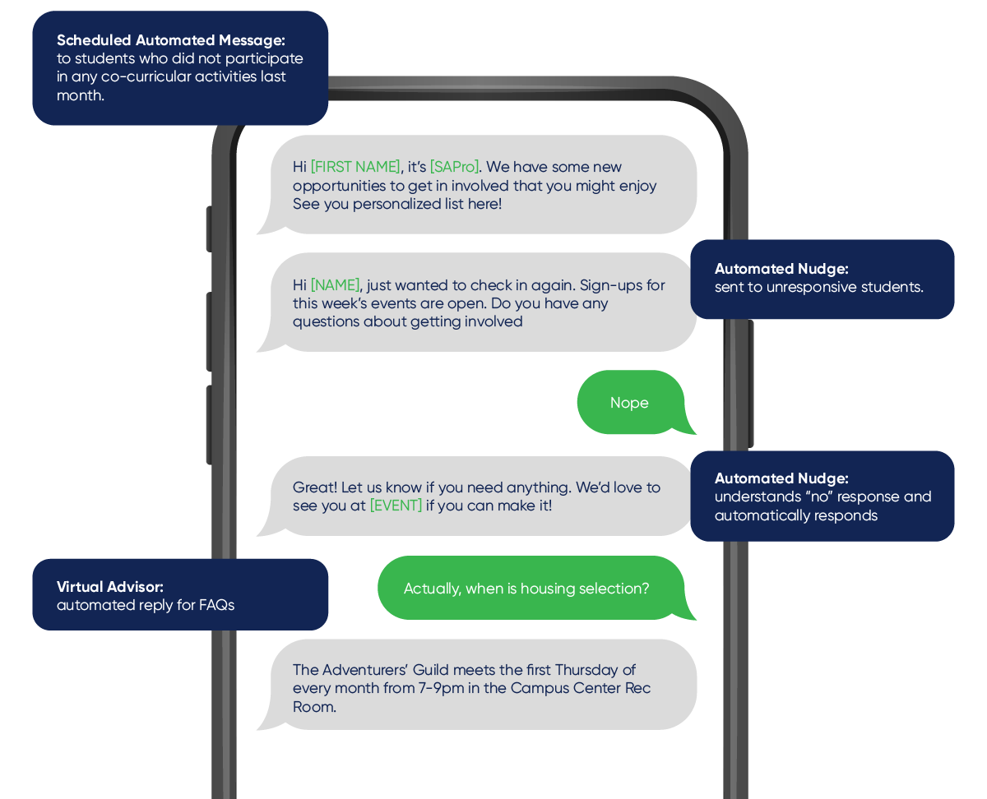
Program Messages
Schedule and send targeted texts
Use data you have in Message
Automate messages based on triggers
Save time! → ”Set it and forget it!”

Slide 28
Automated Response
Creates a conversation
Collect data
Hey Isobel! Are you still interested in applying to Cricket University? Reply yes or no.
Yeah…
Great! Here are some resources to get started! www.cu.edu/apply

Slide 29
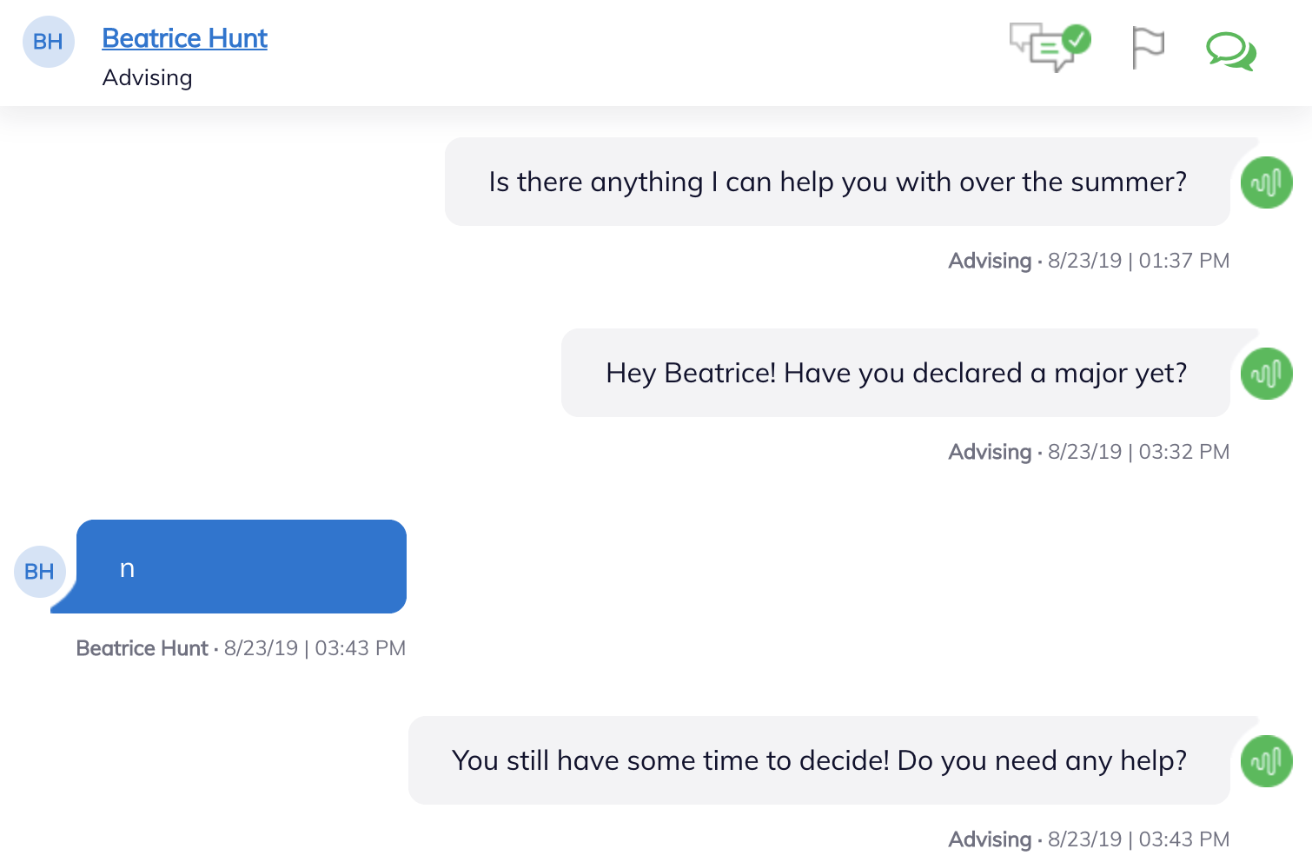
Hey Isobel! Are you still interested in applying to Cricket University? Reply yes or no.
Yeah…
Great! Here are some resources to get started! www.cu.edu/apply

Slide 30
Event Triggered Messaging
Automatically send a message
Based on change in data or event
Eric’s number is entered
and he hasn’t applied yet
Hey Eric! This is Steve here at Cricket University! I’m going to be messaging you through the admissions process, so save this number as CU Admissions. Are you still interested in attending CU in the summer?
Yes!
Great! The application is due soon!

Slide 31
Eric’s number is entered
and he hasn’t applied yet
Hey Eric! This is Steve here at Cricket University! I’m going to be messaging you through the admissions process, so save this number as CU Admissions. Are you still interested in attending SVU in the summer?
Yes!
Great! The application is due soon!

Slide 32
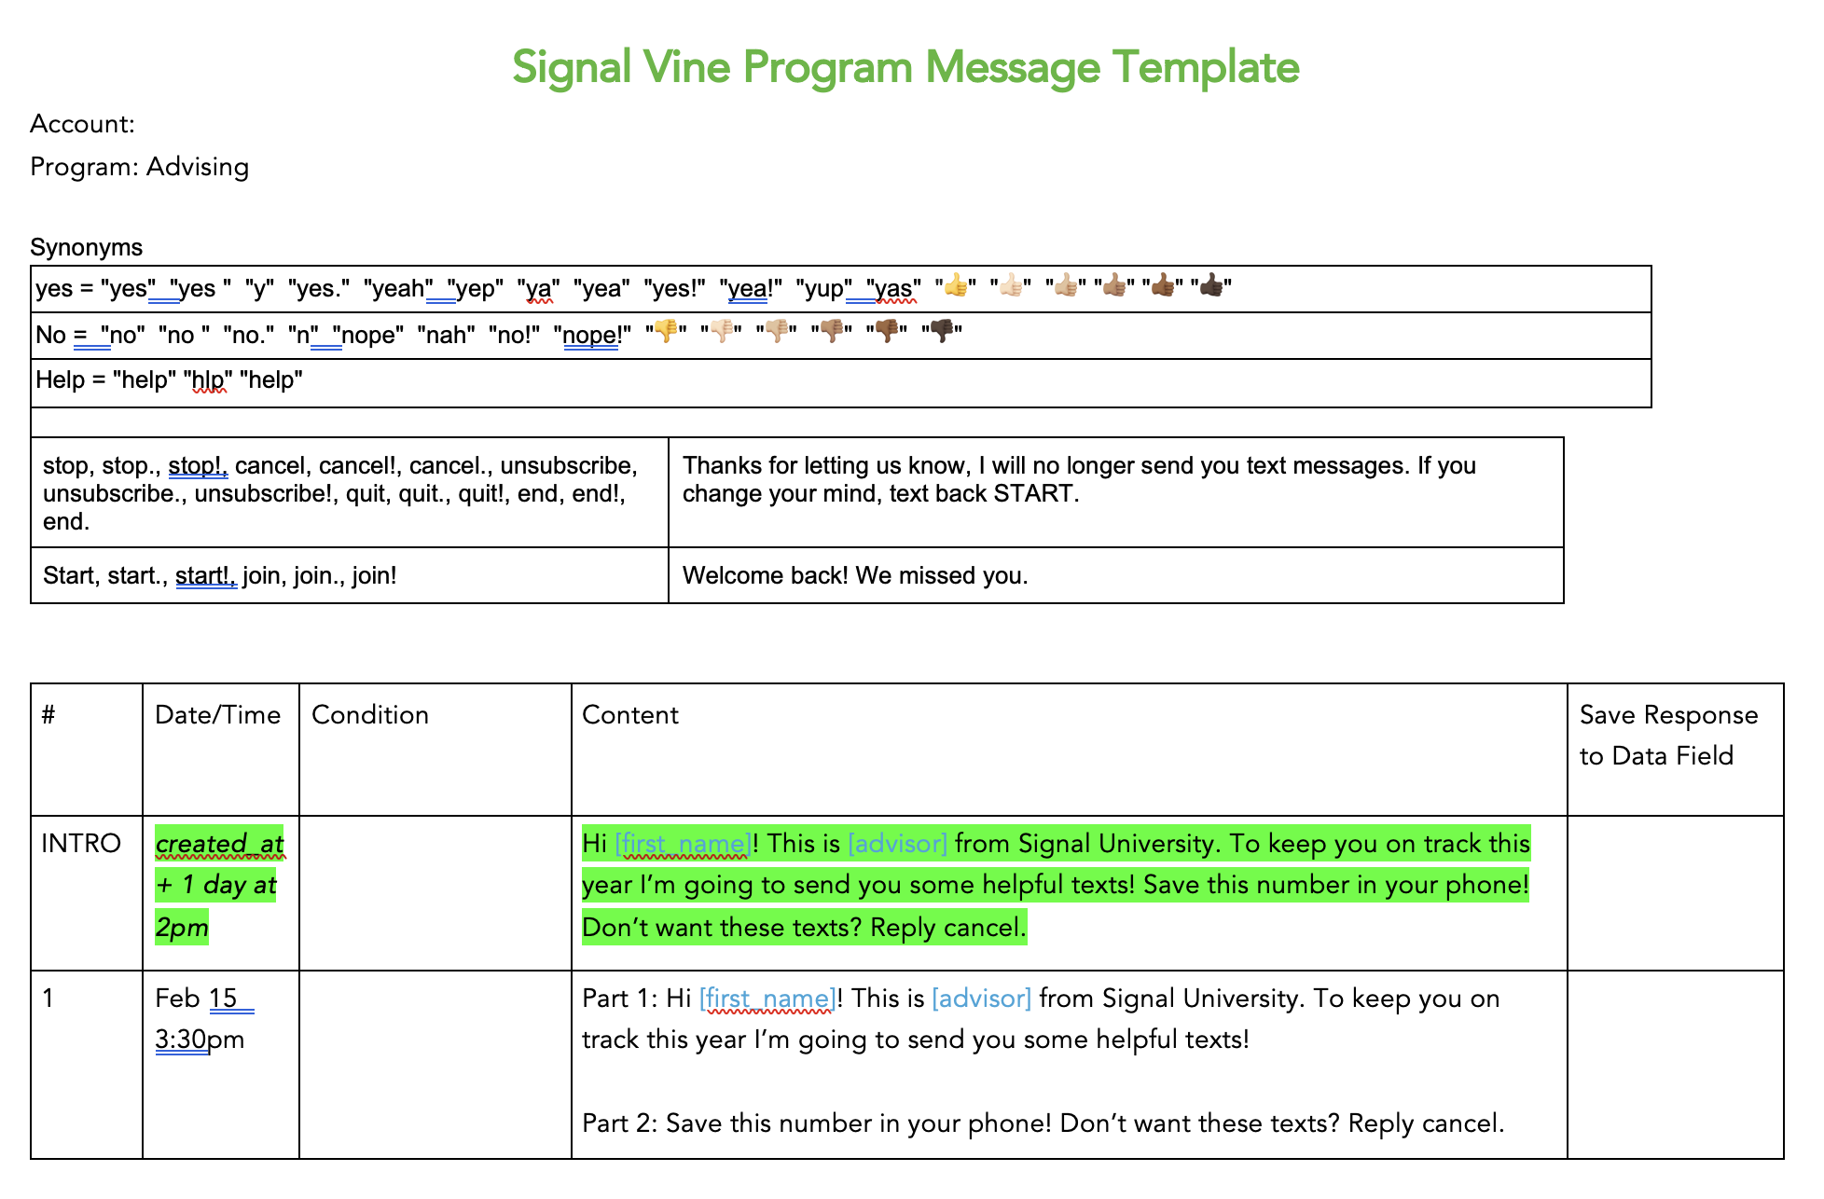
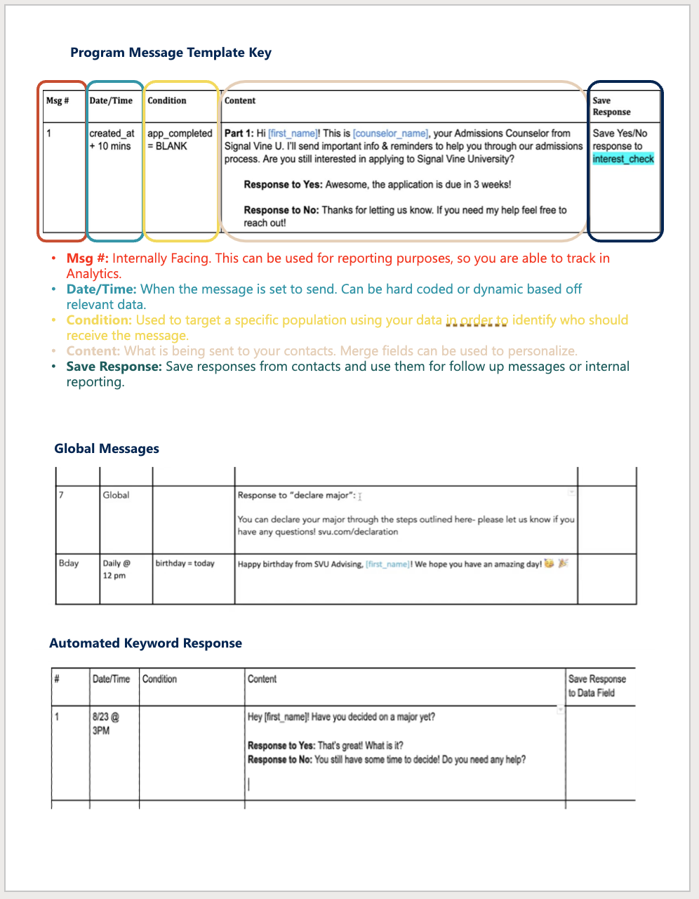
Setting Up Your Program Message
Think through your message
Fill out the template
Work with customer support

Slide 33
Programs Tab

Slide 34
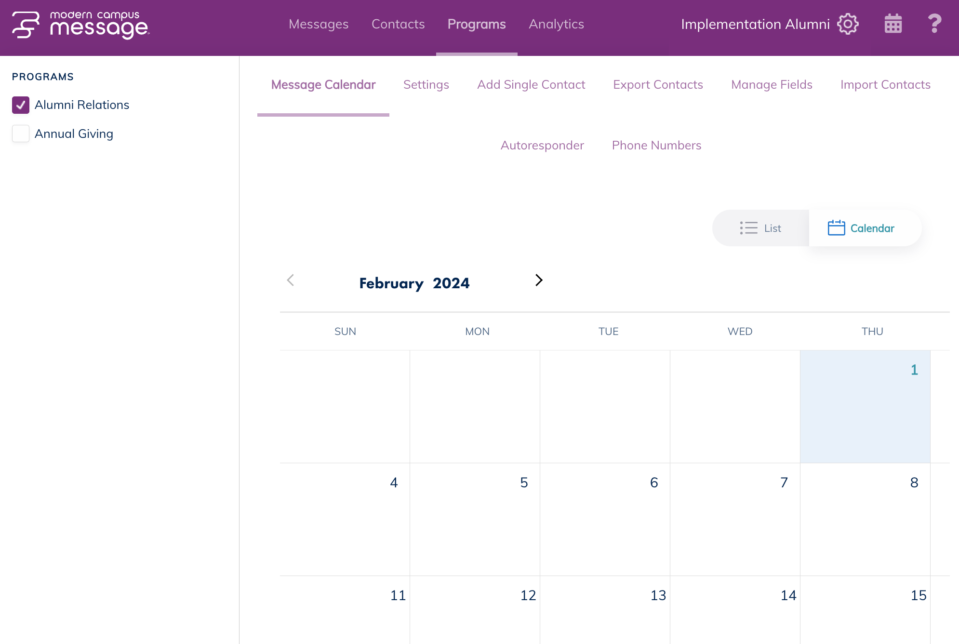
Message Calendar
Shows messages scheduled for 2+ contacts
You can edit / delete messages
DO NOT edit Program Messages (anything you set up with customer support)

Slide 35
Program Settings
Select the right program!
MMS access
Group view
Counselor Access

Slide 36
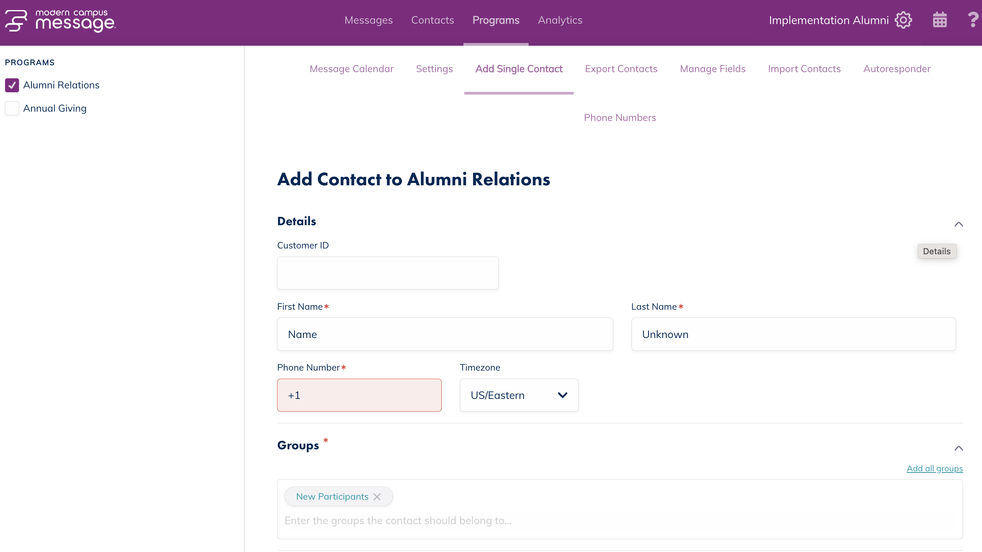
Add a Single Contact
Required fields
Name
Phone Number
Group(s)

Slide 37
Other Program Tabs

Slide 38
Personal Settings

Slide 39
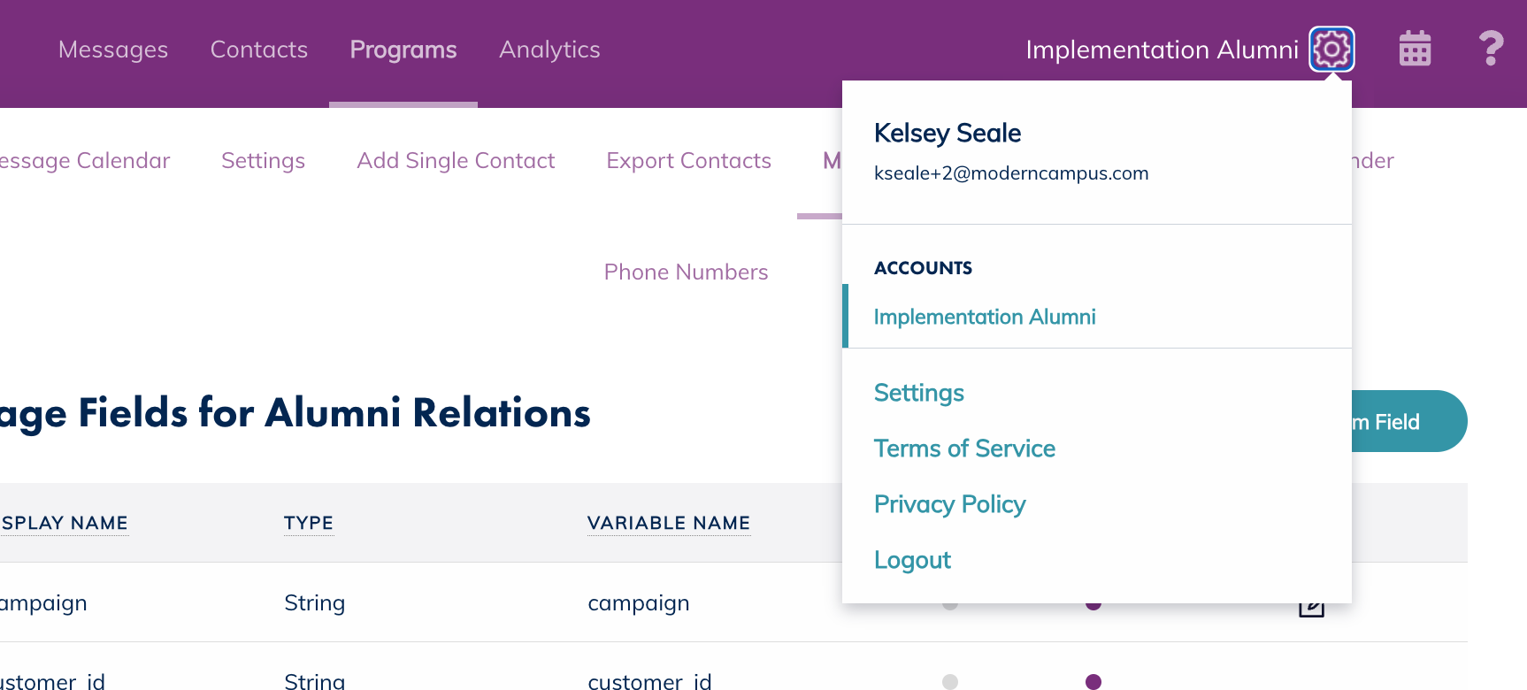
Personal Settings
Click the gear icon
Click “settings”
Manage notification preferences
Manage users

Slide 40
Knowledge Base and Community Forum
Notes:
https://support.signalvine.com/hc/en-us

Slide 41
Knowledge Base
Notes:
https://support.signalvine.com/hc/en-us

Slide 42
Submit a Help Ticket!

Slide 43
What will you put into practice after this webinar?
Answer in the poll!

Slide 44
Q&A
Please put your questions in the Q&A box.
I’ll get to as many as possible and follow up via email if more research is needed!

Slide 45
Thank You
See you next month!
Notes:
Webinar Resources: https://support.signalvine.com/hc/en-us/articles/23861101443341-Message-101-Training-Webinar

